Slide 1
Raspberry Pi Hardware Specifications

Slide 2
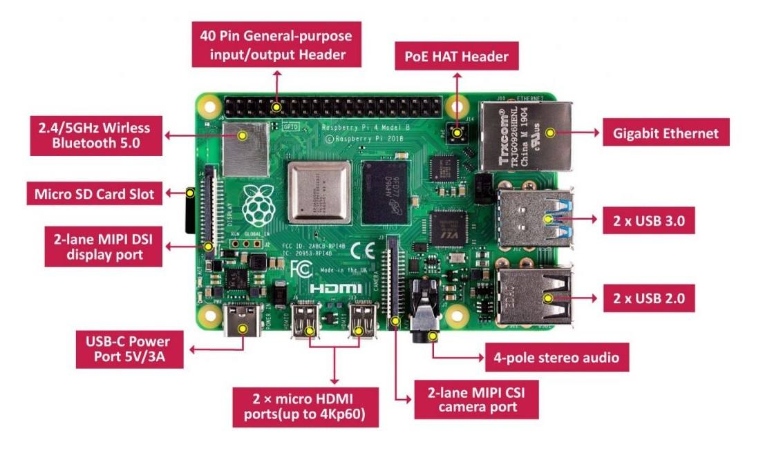

Slide 3
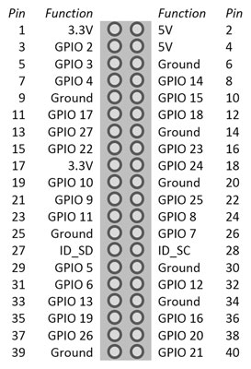
GPIO Pin

Slide 4
Raspberry Pi is known as a single-board computer. Similar to a desktop, laptop, or smartphone, it is a computer constructed from a single printed circuit board.
The Raspberry Pi 4 is the 4th generation of the mainline series of Raspberry Pi single-board computers.
Developed by Raspberry Pi Trading and released on 24 June 2019, the Pi 4 came with many improvements over its predecessor; the SoC was upgraded to the Broadcom BCM2711, two of the Raspberry Pi's four USB ports were upgraded to USB 3.0, and options were added for RAM capacities larger than the 1 GB standard for the preceding Raspberry Pi 3 series.
Raspberry Pi standard 40 pin GPIO header (fully backwards compatible with previous boards)
2 × micro-HDMI® ports (up to 4kp60 supported)
2-lane MIPI DSI display port

Slide 5
2-lane MIPI CSI camera port
4-pole stereo audio and composite video port
Micro-SD card slot for loading operating system and data storage
5V DC via USB-C connector (minimum 3A*)
5V DC via GPIO header (minimum 3A*)
Power over Ethernet (PoE) enabled (requires separate PoE HAT)
Operating temperature: 0 – 50 degrees C ambient
A good quality 2.5A power supply can be used if downstream USB peripherals consume less than 500mA in total.
https://www.naukri.com/code360/library/features-of-raspberry-pi

Slide 6
Software & OS
Raspberry Pi OS (previously called Raspbian) is the recommended operating system for normal use on a Raspberry Pi.
Raspberry Pi Imager is the quick and easy way to install Raspberry Pi OS and other operating systems to a micro SD card, ready to use with your Raspberry Pi.
Raspberry Pi OS is a free, Debian-based operating system optimised for the Raspberry Pi hardware.
Raspberry Pi OS supports over 35,000 Debian packages. We recommend Raspberry Pi OS for most Raspberry Pi use cases.

Slide 7
